Slide 1
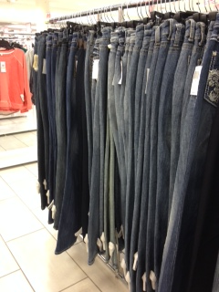
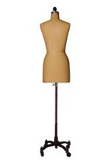
Apparel Industry Construction Methods

Slide 2
Key Terms
Lockstitch Machine
Overlock Machine
Blind Hem Machine
Buttonhole Machine
Embroidery Machine
Stitches per inch (SPI)
ASTM International
Classes of Stitches
Chainstitch
Coverstitch
Lockstitch
Staystitching
Directional Stitching
Understitching
Topstitching
Edge Stitching
Stitch-in-the-ditch
Classes of Seams
Super Imposed Seams

Slide 3
Key Terms
Lapped Seams
Bound Seams
Flat Seams
Edge Finished Seams
Ornamental Seams
Shaping Devices
Kinds of Pleats
Kinds of Tucks
Kinds of Facings
Kinds of Sleeves
Kinds of Collars
Kinds of Cuffs and Plackets
Kinds of Waistbands
Kinds of Pockets
Zippers
Hems
Product Engineering- Operational Breakdown

Slide 4
Equipment Used in Apparel Manufacturing
Industrial Lockstitch Sewing Machine- commonly used for simple construction.
Blind Hem Machine- used for hemming.
Flatlock Machine-used for seaming knit fabrics.
Overlock Machine-great for knit fabric construction.
Buttonhole Machine – used for making buttonholes
Embroidery Machine – used for embroidery and monogramming

Slide 5
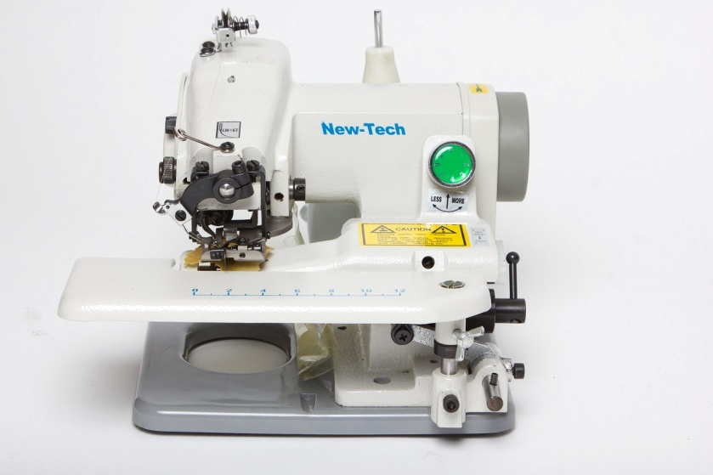
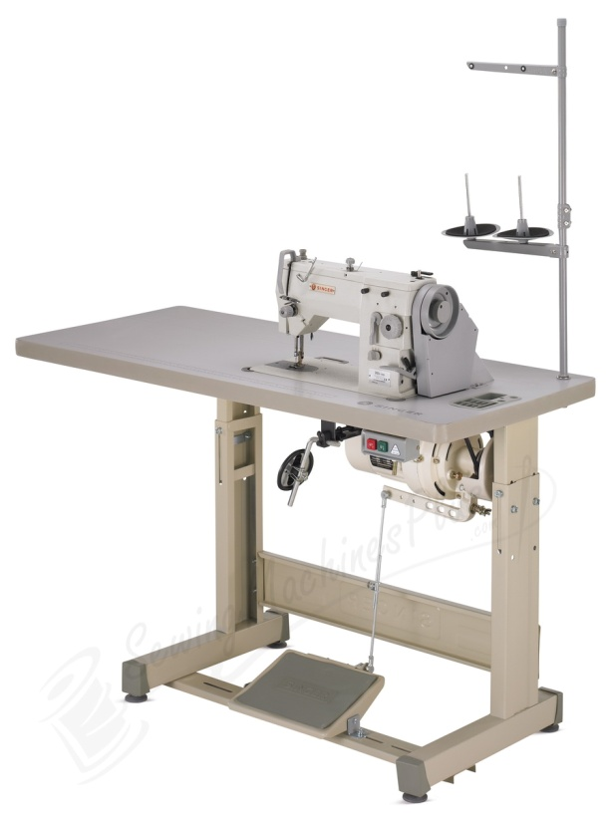
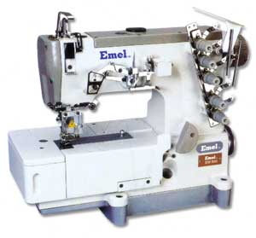
Types of Machines
Blind Hem Machine
Single/Multi Needle Industrial Lockstitch Sewing Machine
Flatlock Machine

Slide 6
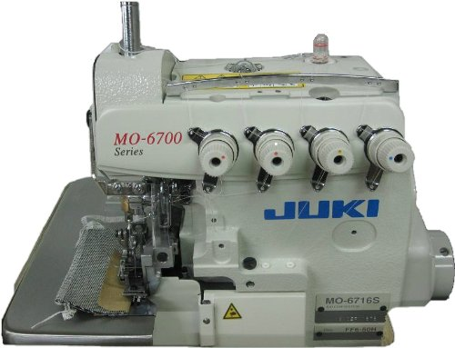
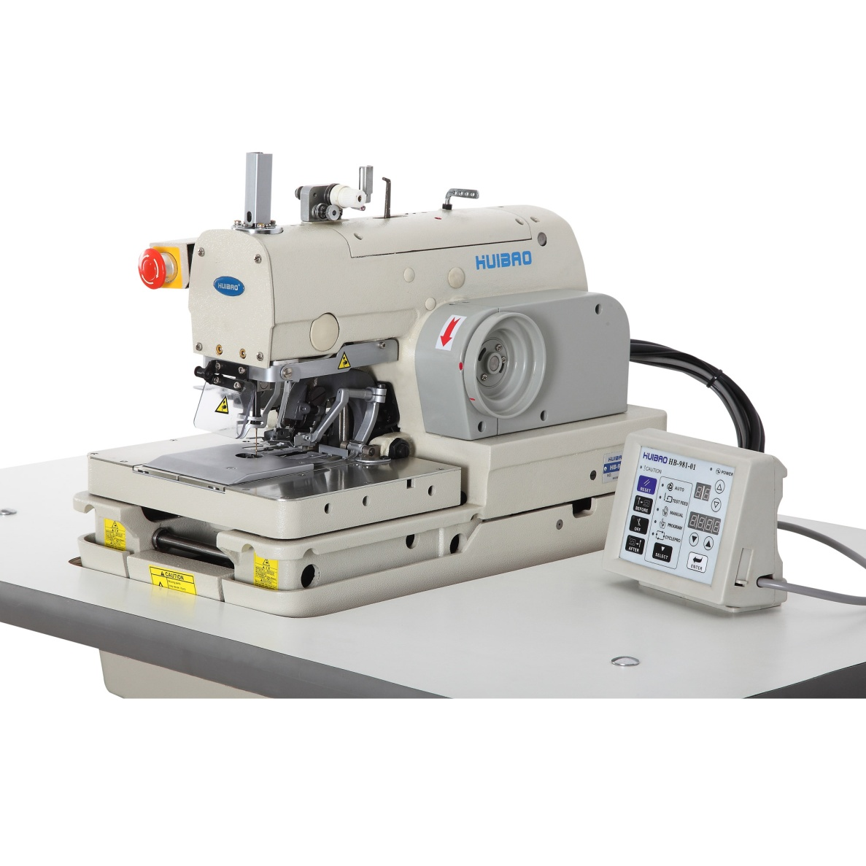
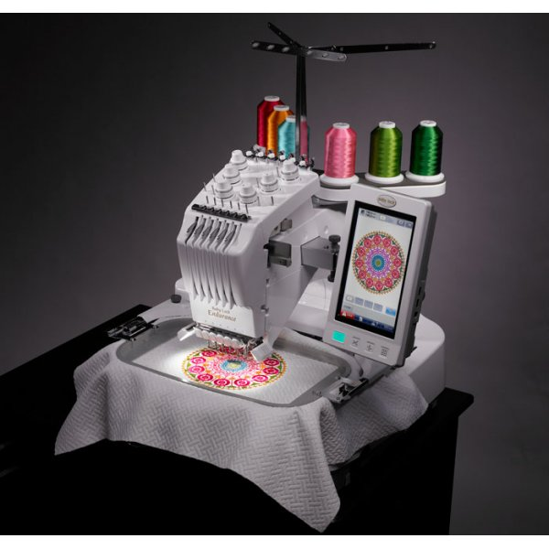
Overlock Machine
Buttonhole Machine
Embroidery Machine

Slide 7
Industrial Sewing Facts
Industrial sewing machines can sew faster than home sewing machines.
Industrial machines sew up to 6500 stitches per minute (SPI). A home sewing machine sews 250 to 1000 (SPI).

Slide 8
Factors to Consider Before Garment Construction…
Prior to sewing fashion professionals must understand basic machine and equipment changes need to be made based on the design and fabrication they are working with.
Consider…
Stitches per inch
Needle selection
Thread selection

Slide 9
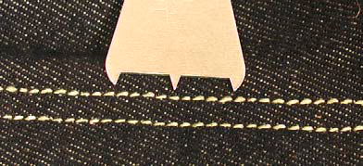
(SPI)Stitches Per Inch
View Link for to see a chart of industry recommended SPI for various garments. Link: http://www.amefird.com/wp-content/uploads/2010/01/Selecting-the-right-SPI-2-5-10.pdf

Slide 10
Sewing Machine Needle Consideration
Needle Sizes:
Needle Size | Fabrication
60/8 | Silk, Batise, Rayon, Sheer Fabrics
70/10 | Chambray, Sheeting, Gingham, Quilting Cotton
80/12 | Chambray, Sheeting, Gingham, Medium Weight Cotton
90/14 | Chambray, Sheeting, Gingham, Quilting Cotton
100/16 | Canvas, Denim, Upholstery Fabric

Slide 11
Needle Type | Fabrication
Sharps or Universal | Sharp point, safest for everyday regular use on most woven fabrics.
Ball Point | Rounded point, best for knits, mesh, and interlock knits.
Denim | Heavier duty, best for denim, ducking, and canvas.
Wedge Points or Leather | Sharp knife like tip, best for leather and vinyl.
Metallic or Embroidery | Especially made for metallic, rayon, or acrylic thread. Smaller needle head
Top Stitching | For heavier top stitching such as buttonhole twist, or if using double thread.
Twin & Triple Needles | Great for pin tucking, decorative stitching
Stretch Needles | Great for spandex, active wear knits and swimwear.
Micro Point | Sharper point, great for fine dense fabrics, ribbons.

Slide 12
ASTM International
Formally known as the American Society for Testing and Materials.
Globally recognized as a leader in the development of standards in many industries, including fashion.
Standards are used to improve product quality, safety, and build consumer confidence.
Click here to Check it out...

Slide 13
Classes of Stitches
Six classes of stitch types
Stitch Class | Name | Typical Uses
100 | Single Thread Chain Stitch | Decorative, western wear, used at hems
200 | Hand Stitch
300 | Lockstitch- variations include- plain, zigzag, | 1. Plain- used to set pockets, zippers 2. Zigzag-used for athletic wear, decorative, buttonholes, bar tacks on jeans
400 | Multi Thread Chain Stitch | Decorative stitching on belts. Parallel rows of stitches for lapped side seams of woven shirts and jeans.
500 | Overedge and Safety Stitch | Shirts, jackets, blouses and jeans.
600 | Cover Stitch or Flat Seam Stitch | Knits and lingerie
ASTM D 6193

Slide 14
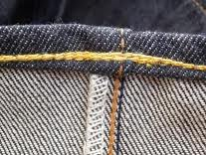
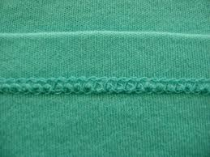
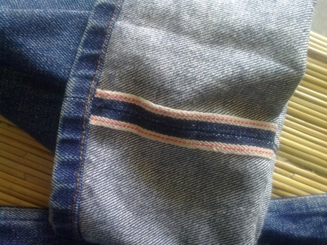
Common Industrial Sewing Machine Stitches
Chainstitch –
Stitch that interloops the needle thread(s) with a bottom looper thread on the underside of the seam.
This stitch is used on most seams in woven apparel.
Coverstitch –
Stitch that is often used to seam knitwear.
It consists of at least two needle threads, a looper thread and a top thread passing over the edge of the material.
Lockstitch –
This is the most common stitch formed on industrial sewing machines.
A stitch formed by interlocking needle threads with a bobbin thread.

Slide 15
Classes of Seams and Seam Finishes
In the Apparel Industry seam types are categorized according to their structure.
Class of Seam | Name
SS | Superimposed Seams
LS | Lapped Seams
BS | Bound (Binding ) Seams
FS | Flat (Butted) Seams
EF | Edge Finished Seams
OS | Ornamental Seams
Standardized system to help with communicating between countries.
ASTM D 6193

Slide 16
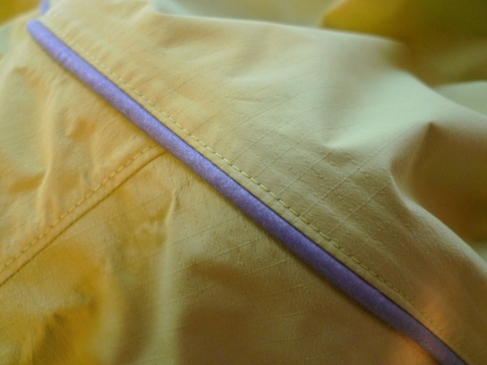
Super Imposed Seams (SS)
Most common seam construction.
Created by sewing two or more layers of fabric together. Example: Plain Seam
Variations Include:
French Seam
Double Stitched Seam
Piped Seam

Slide 17
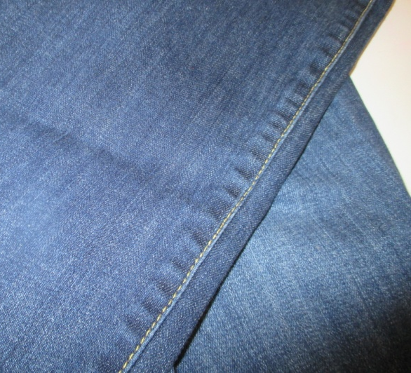
Lapped Seams (LS)
Created by overlapping two or more pieces of fabric.
Some examples include:
Flat-felled seam- sewing sides of jeans
Welt seam- stronger than a plain seam, can be used on thicker fabrics
Center seam of jeans
Inseam of jeans

Slide 18
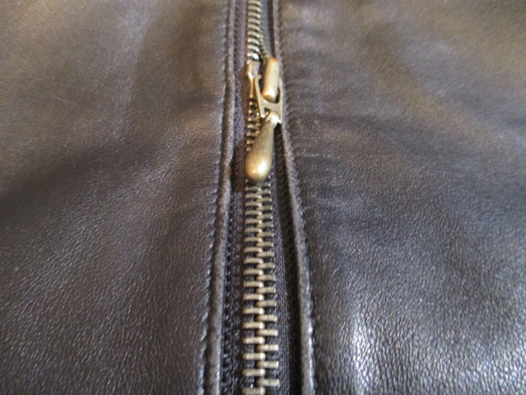
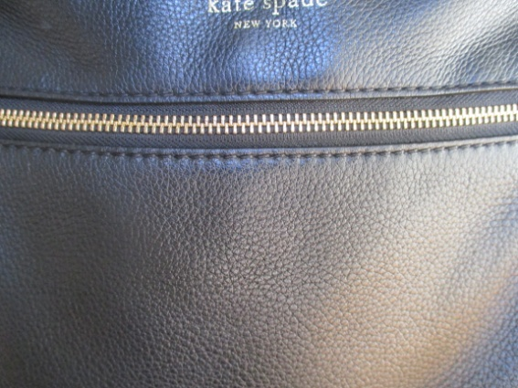
Lapped Seams (LS)
Lapped seam- common with suede and leather
Leather Jacket
Leather Purse

Slide 19
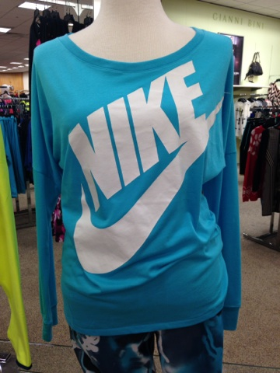
Bound Seams (BS)
Made to finish and edge of a garment.
Is one piece of fabric encompassing the raw edge of another piece of fabric.
Example- Neckline of a Crew T-shirt

Slide 20
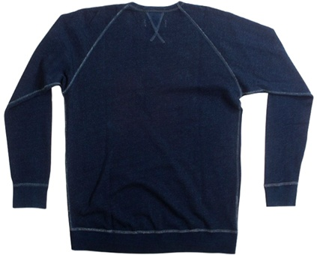
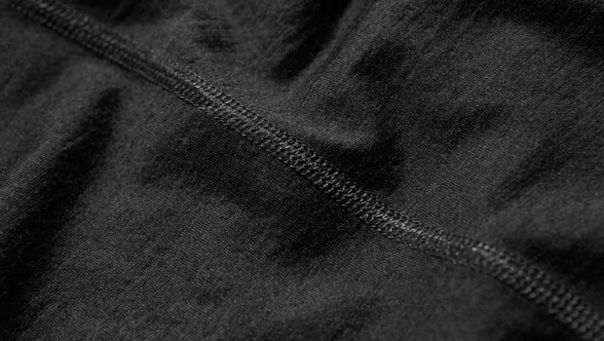
Flat Seam (FS)
Constructed by having two pieces of fabric meet at the edge.
Coverstitch is used to join or sew the fabric pieces together with no overlap.
Creates a flat seam.

Slide 21
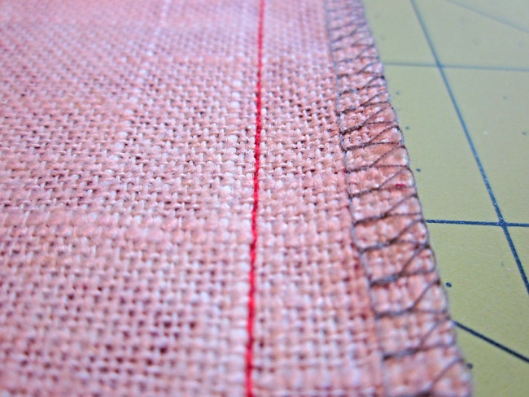
Edge Finished Seams (EF)-
This seam is used to prevent edges from rolling or curling.
Great for knit fabrics.
Ornamental Seam (OS)-
This seam is made using machines with zigzag capability. It is used on a plain seam on woven or knit fabric.

Slide 22
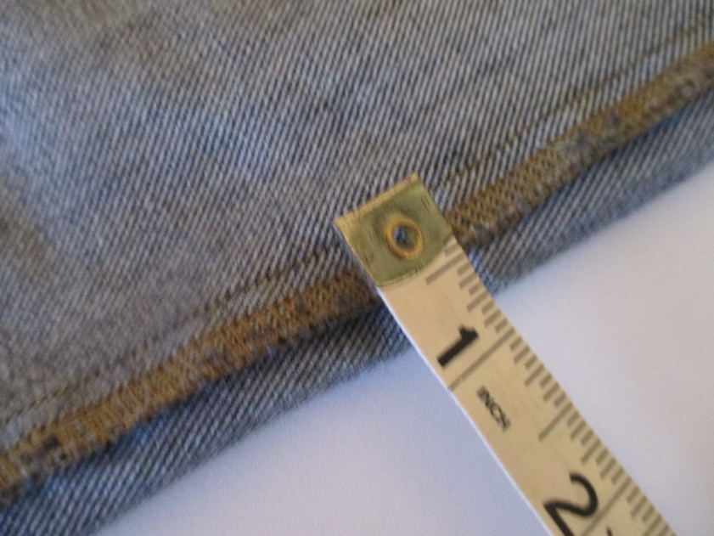
Seam Dimensions
The seam length, width, and depth:
Affect garment quality performance, and costs.

Slide 23
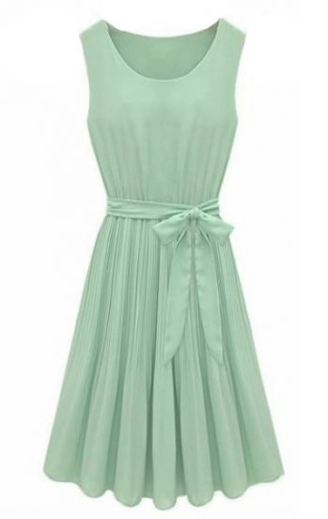
Seam Engineering
Seam Length- How long the seam is.
Seam Width- How wide…Seam allowance is typically finished between 1/4"to ½".
Seam Depth- thickness or flatness of a seam. Affects appearance and comfort.

Slide 24
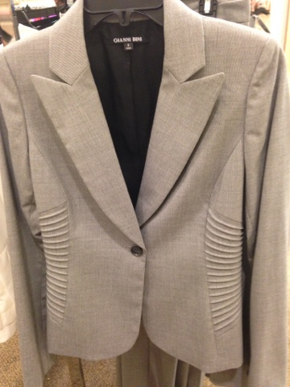
Construction Details
SET-IN SLEEVES
LAPEL
PRINCESS SEAMS
TUCKS
BUTTONHOLE

Slide 25
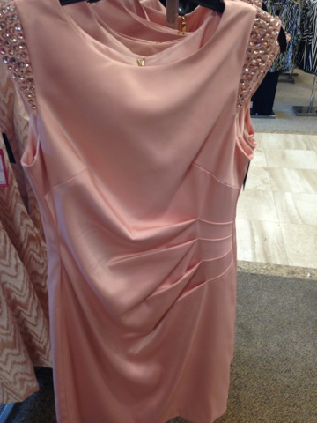
Garment Shaping Devices
Darts
Tucks
Pleats
Gathers
Princess Seams

Slide 26
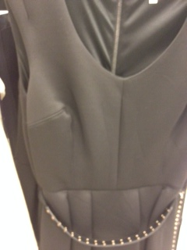
Darts
Single pointed
Double pointed
Commonly used at bust lines and waist.

Slide 27
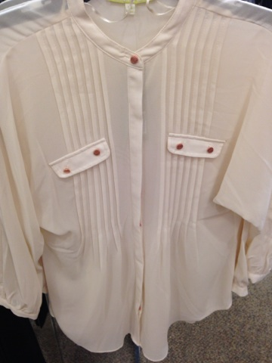
Tucks
Pin Tucks

Slide 28
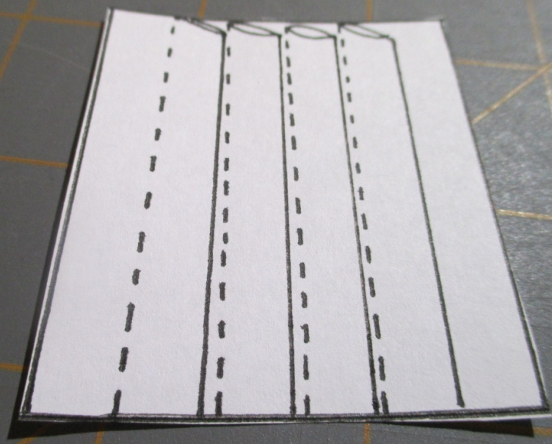
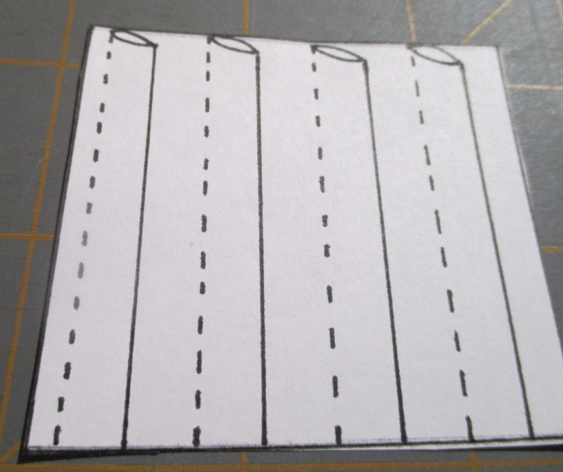
Blind Tucks
Space Tucks
Tucks are constructed by folding and stitching vertically down the fold.

Slide 29
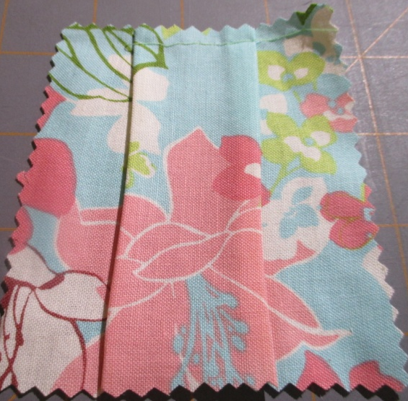
Pleats
Box
Knife
Inverted
Pleats are constructed by folding fabric typically at the waist to control fullness and create design ease.

Slide 30
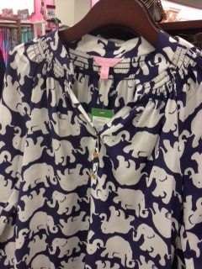
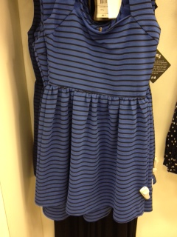
Gathers
Gathers are constructed by easing fabric to create soft folds at the waist, neckline and sleeve caps.

Slide 31
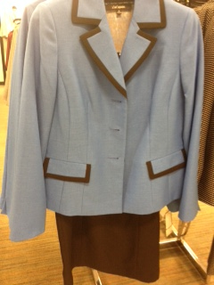
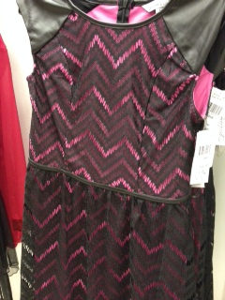
Princess Seams

Slide 32
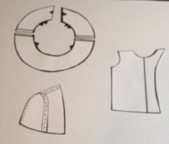
Facings
Extended- incorporated into the front pattern piece.
Fitted- separate pattern piece that will be cut and attached.
Bias- thin strip fabric cut on the bias for armhole and neck edge.

Slide 33
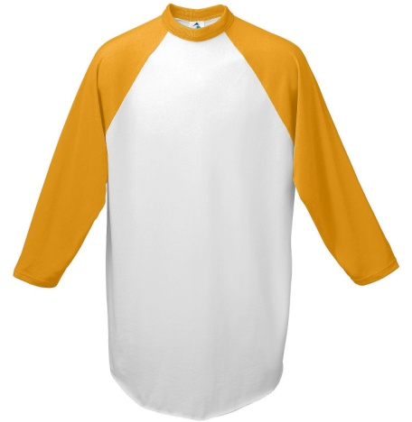
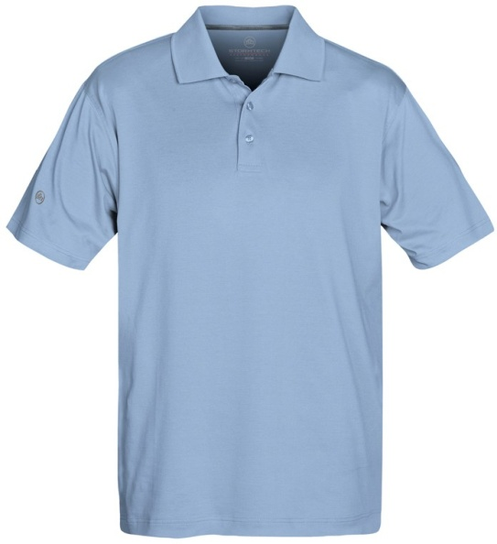
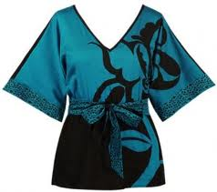
Sleeves
Raglan Sleeve- sewn with a diagonal seam.
Set-In Sleeve- attached at the armhole.
Kimono Sleeve- sleeve and body are one piece.

Slide 34
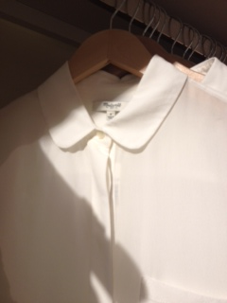
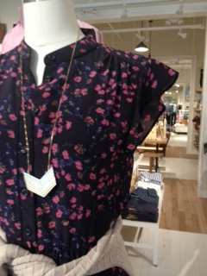
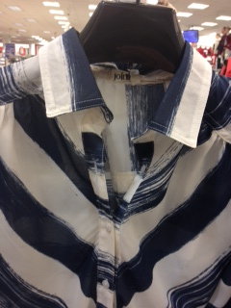
Collars
Flat Collar- lies flat against the garment next edge.
Rolled Collar- stands up slightly and rolls over and around the neck edge; found in most button down shirts.
Standing Collar- upright band attached to the neckline.

Slide 35
Waistbands
Casings-are used to enclose drawstrings or elastic and often found in sportswear. Example: pull on pant or skirt.
Waistband- Interfaced attachment used with zipper and hook and bar fasteners at the edge of dress pants and fitted skirts.
Facing- curved piece of fabric attached and folded to the inside of a garment.

Slide 36
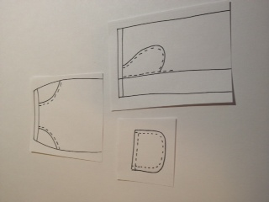
Pockets
Common Pockets:
Front Hip- angular pocket, commonly found on denim pants, and skirts.
Inseam- hidden pocket attached at the side seam.
Patch- attached to the outside of a garment. May be made from the same fabric as the garment or a contrasting fabric.

Slide 37
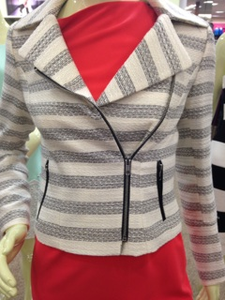
Fasteners: Zippers
Centered- two rows of stitching visible on the outside of a garment.
Lapped- one row of visible stitches on the outside. Commonly found in dress pants and skirts.
Fly Front- large lap in the front of a pair of jeans or casual pants or skirts.
Invisible- no visible stitching on the outside of garment.

Slide 38
Hems
Hems are typically 1 ¼"
Hand and/or Machine Hems commonly used in R-T-W garments.
Hand | Machine
Catch Stitch- expensive, labor intensive | Machine Blind- used on dress pants, skirts etc.
 | Top Stitch- used on casual sportswear, jeans.
 | Narrow Rolled Hem- used on light or sheer weight fabrics, hem of skirts, tops etc.

